Slide 1
Fundamental Review of the Trading Book
Chapter 27

Slide 2
History of the Determination of Market Risk Capital
Basel I: Capital based on 10-day 99% VaR (minimum multiplier=3)
Basel II.5:
  Capital based on 10-day 99% VaR and 10-day 99% stressed VaR
  Incremental risk charge for credit instruments to prevent regulatory arbitrage between banking book and trading book
  Comprehensive risk measure for correlation-dependent instruments

Slide 3
FRTB Background
First proposed in 2012
Final rules published in 2019
Implementation starting in 2023

Slide 4
Use of Expected Shortfall
VaR with a 99% confidence level is being replaced by ES with a 97.5% confidence level
The two measures are almost exactly the same when applied to normal distributions but the second measure is higher for distributions with heavier tails than the normal distribution
ES (97.5% confidence) to be based on a stressed period of 250 days

Slide 5
The Shocks to Market Variables
The 10-day time horizon used for VaR in Basel I and Basel II.5 is being replaced by a calculation where the time horizon used for a market variable (risk factor) in ES calculations depends on its liquidity
Time horizons of 10, 20, 40, 60, and 120 days are used

Slide 6
Examples (Table 27.1)
Risk Factor | Time Horizon
Equity price (large cap) | 10 days
Precious metal price | 20 days
Credit spread corporate (investment grade) | 40 days
Interest rate volatility | 60 days
Credit spread volatility | 120 days

Slide 7
Calculations
Standardized approach
Internal models approach
Banks must provide results for both approaches if they have been approved for the internal models approach.

Slide 8
Standardized Approach (Section 27.2)
Sum of:
A risk charge based on weighted sensitivities, which is sum of
  Delta measure
  Vega measure
  Curvature measure
A default risk charge
A residual risk add on

Slide 9

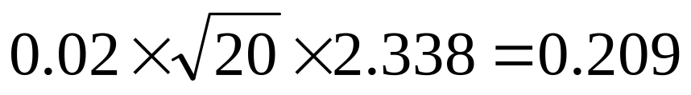
Delta and Vega
Capital charge has the form
The weights W_{i} and correlations ρ_{ij} are set by Basel. The “deltas” are determined by the bank.
The weights are standard deviations or volatilities of daily changes in stressed markets multiplied by a factor to give confidence level over the liquidity horizon
Example: If daily volatility is 2% and liquidity horizon is 20 days, risk weight might be estimated as

Slide 10
Weighted Sensitivities: Curvature Risk Charge
Banks test the effect of making changes equal to W_{i} to the risk factors
They take out the delta effect to determine an incremental curvature effect
Some diversification taken into account when curvatures are aggregated
Positive curvature effects are counted as zero
When there is a term structure the curvature risk charge is determined by making a single parallel shift

Slide 11
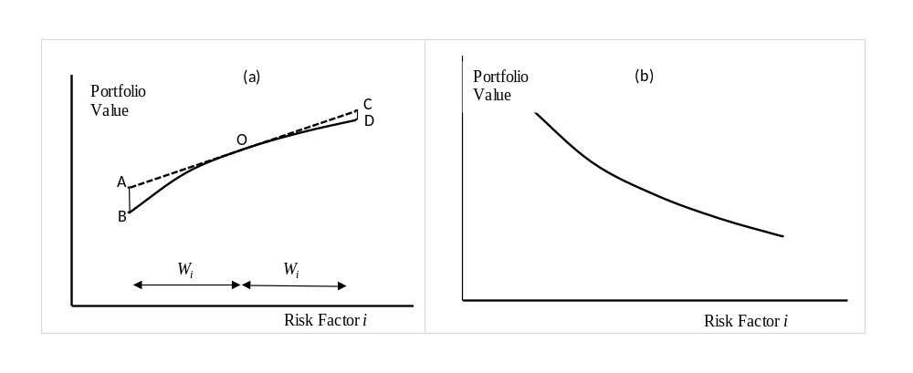
Curvature Risk Charge Calculation
Curvature risk charge = AB
No curvature risk charge

Slide 12
Default Risk Charge
Credit spreads are handled using the delta/vega/curvature calculations
Jump to default handled by a separate default risk charge
Multiply each net exposure by loss given default and a default weight (both specified by Basel)
Example: LGD for senior debt is 75%, and default weight for A-rated counterparty is 3%

Slide 13
Residual Risk Add On
Considers risks not well handled by the delta/gamma/curvature approach (e.g. exotics)
Notional amount is multiplied by a risk weight (1% for exotics)

Slide 14
The Internal Models Approach
Calculation is to be based on overlapping 10-day periods and five ES calculations:
  All variable changed (ES₁)
  All variable except those with a time horizon of 10 days are changed (ES₂)
  All variables except those with time horizons of 10 and 20 days are changed (ES₃)
  All variables except those with time horizons of 10, 20, and 40 days are changed (ES₄)
  All variables except those with time horizons of 10, 20, 40, and 60 days are changed (ES₅)

Slide 15
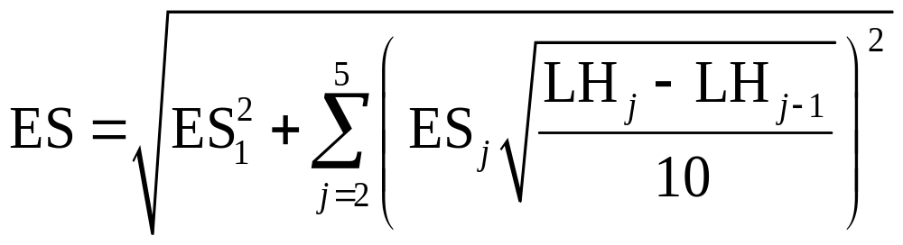
Calculation continued
where LH_{j} is the liquidity horizon in days for the jth category so that
LH₁=10, LH₂=20, LH₃=40, LH₄=60, and LH₅=120

Slide 16
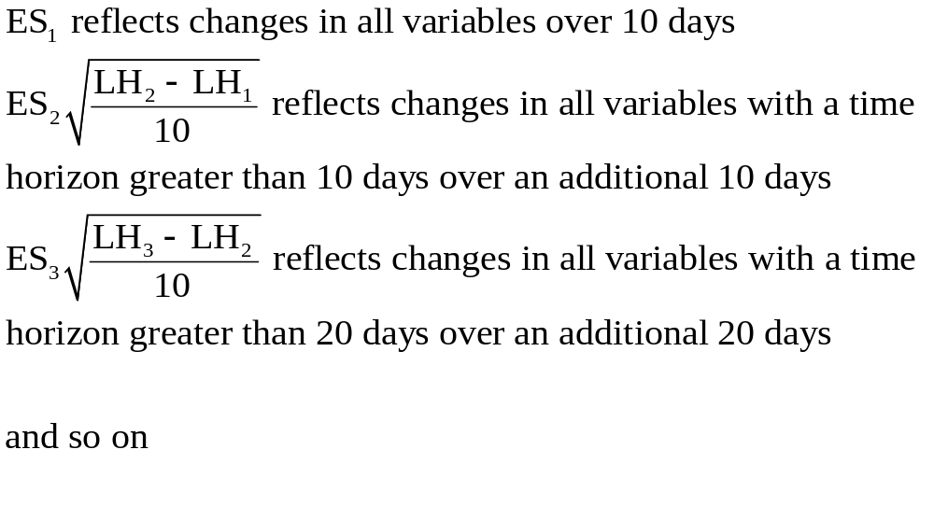
Components of the Final ES

Slide 17
Aggregating Components
Assume that changes in one period are independent of change other period
An approximation to the total ES that we are interested is then obtained by taking the square root of the sum of the squares of the component ESs

Slide 18
Other Details
Calculations based on stressed periods
Search for stressed periods can involve a subset of market variables providing these account for 75% of the current ES
Partial ESs must be calculated for risk classes. Capital under the internal models approach is a multiplier of the weighted average of a) the total ES and b) the sum of the partial ESs
Current one-day VaR (99% and 97.5% confidence levels) are backtested
P&L attribution tests must be carried out

Slide 19
Other Details continued
Standardized approach must be used if number of exceptions is greater than 12 at 99% confidence or 30 at 97.5% confidence
P&L attribution tests based on:
  (Mean unexplained by model)/(SD of daily change)…should be between -10% and +10%
  (Variance unexplained by model)/(variance of daily change)…should be less than 20%
Special rules for “non-modelable” risk factors involving stress tests

Slide 20
Internal Models Approach: Credit Trades
Jump to default risk is handled similarly to Basel II with capital based on one-year 99.9% VaR
Spread risk is handled along side other market risks

Slide 21
Trading Book vs. Banking Book
FRTB makes the distinction between the trading book and the banking book clearer (to avoid arbitrage)
It has rules covering the (very rare) situations when instruments can be moved from one book to another (There is no capital advantage to the bank when this happens)

